Slide 1
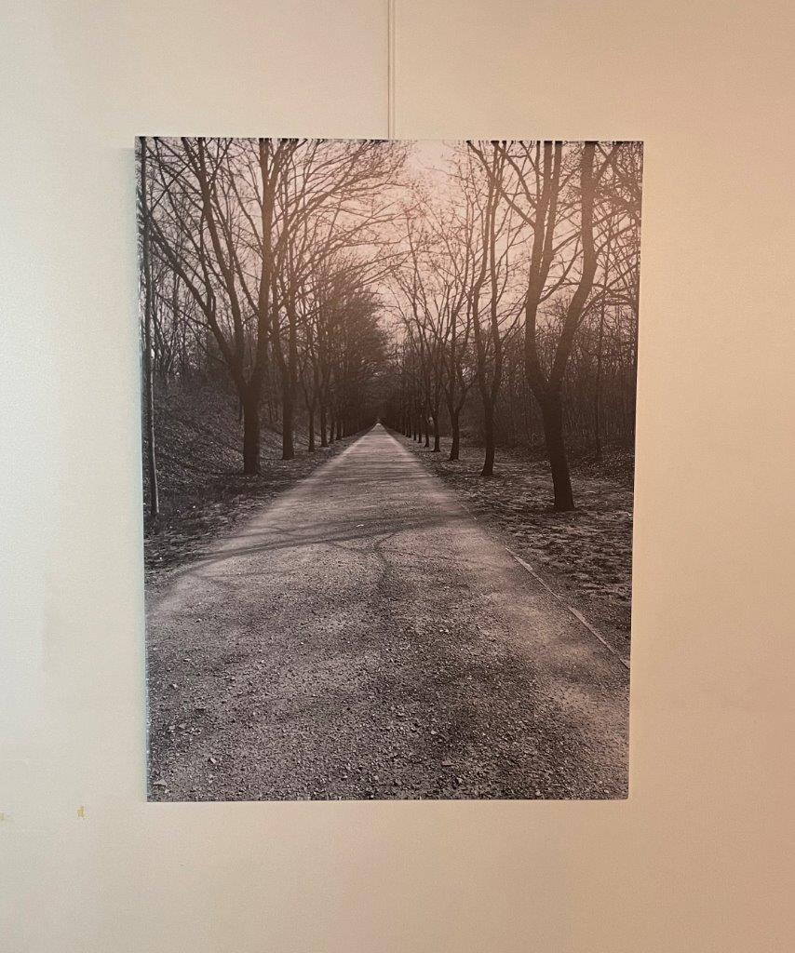
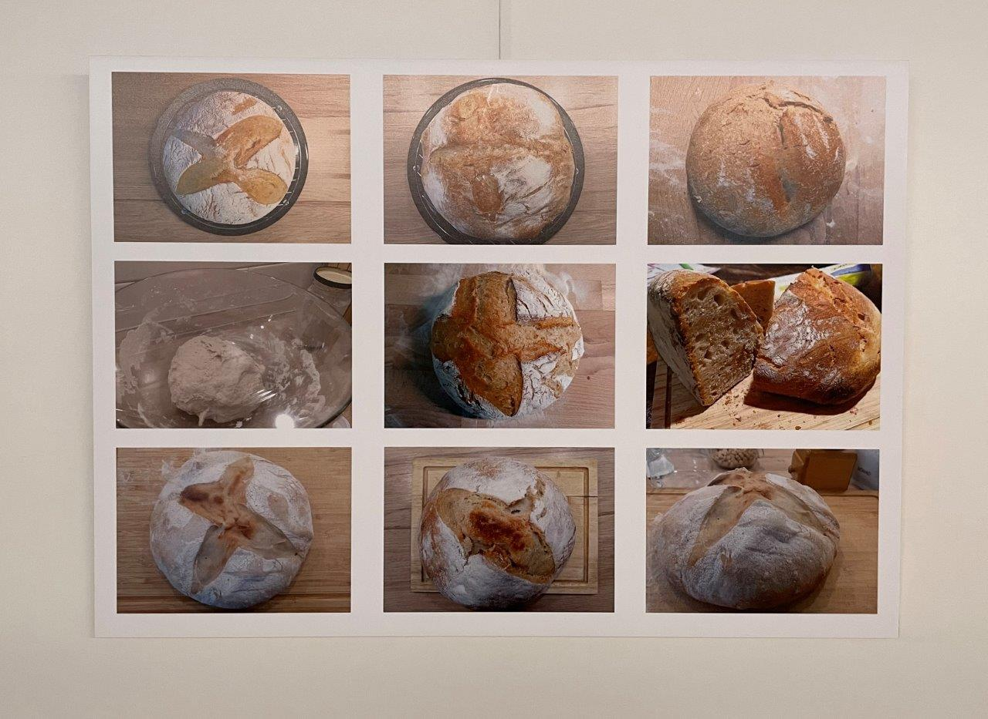
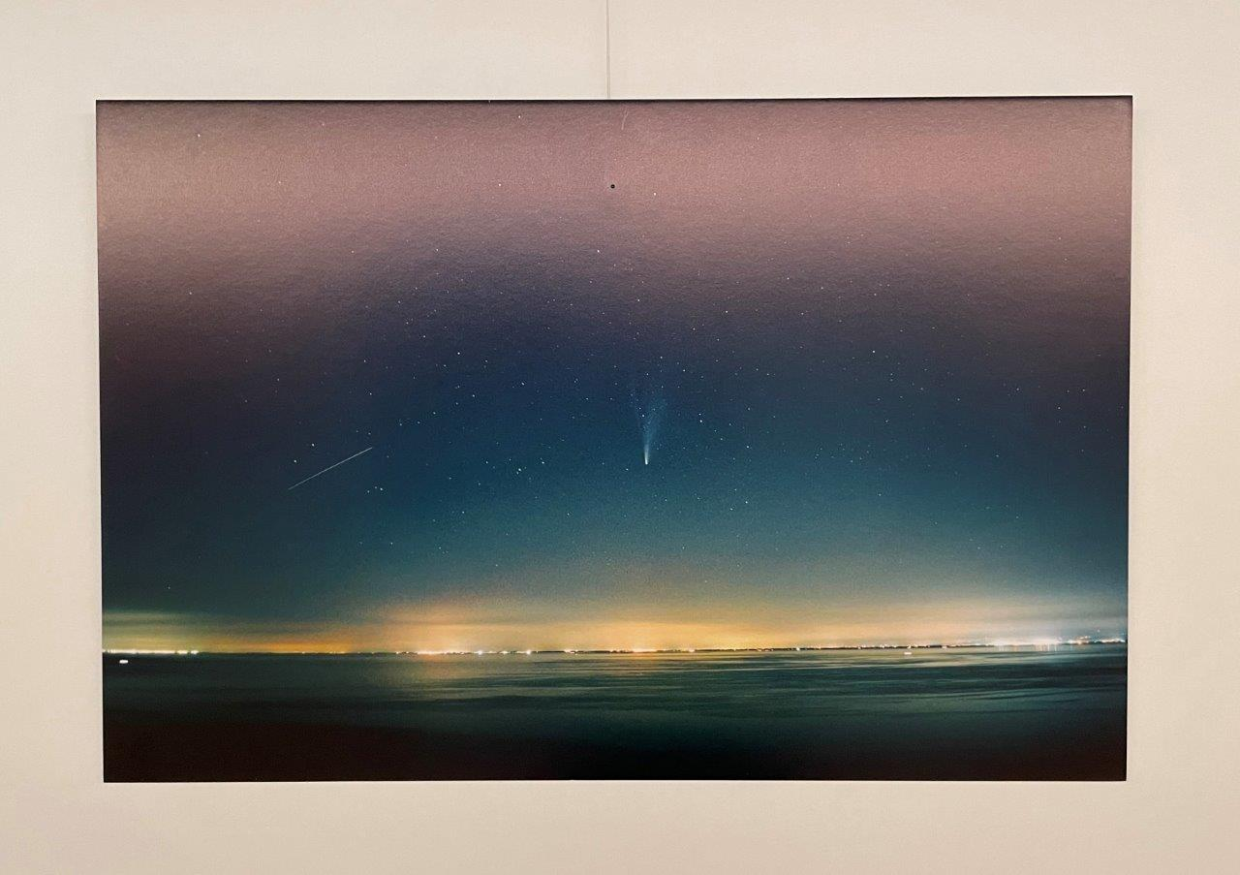
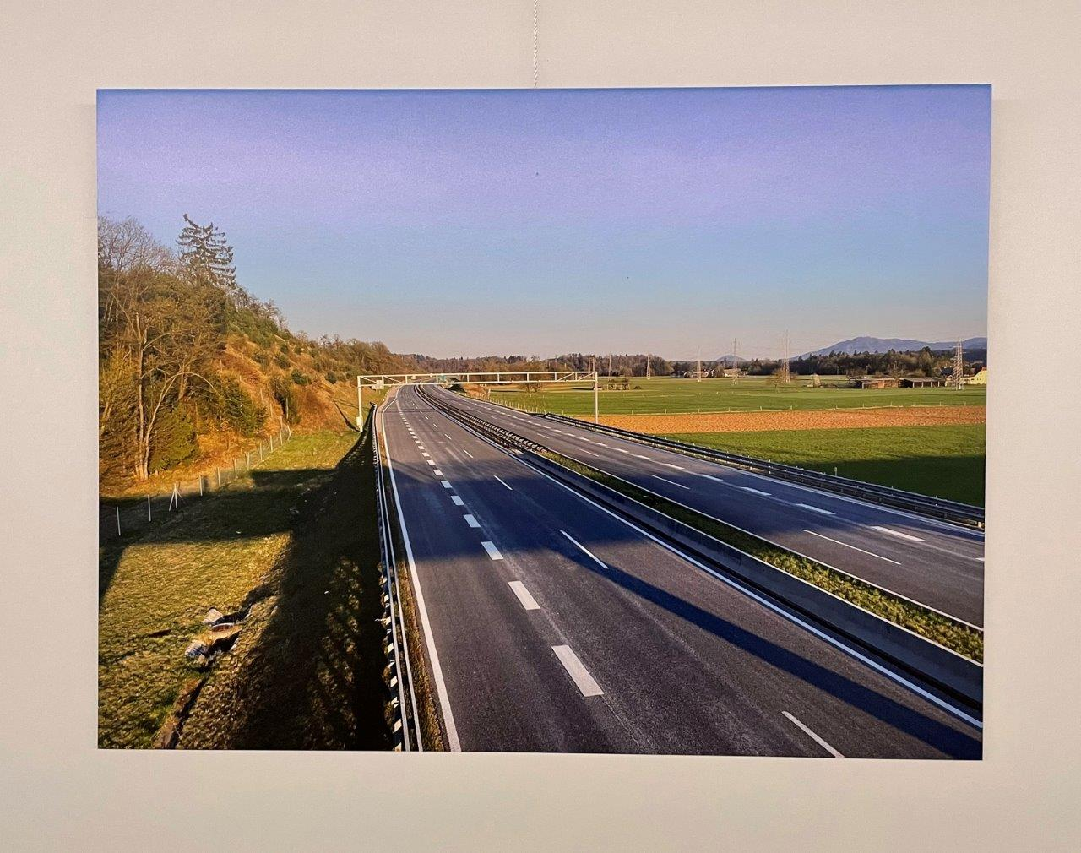
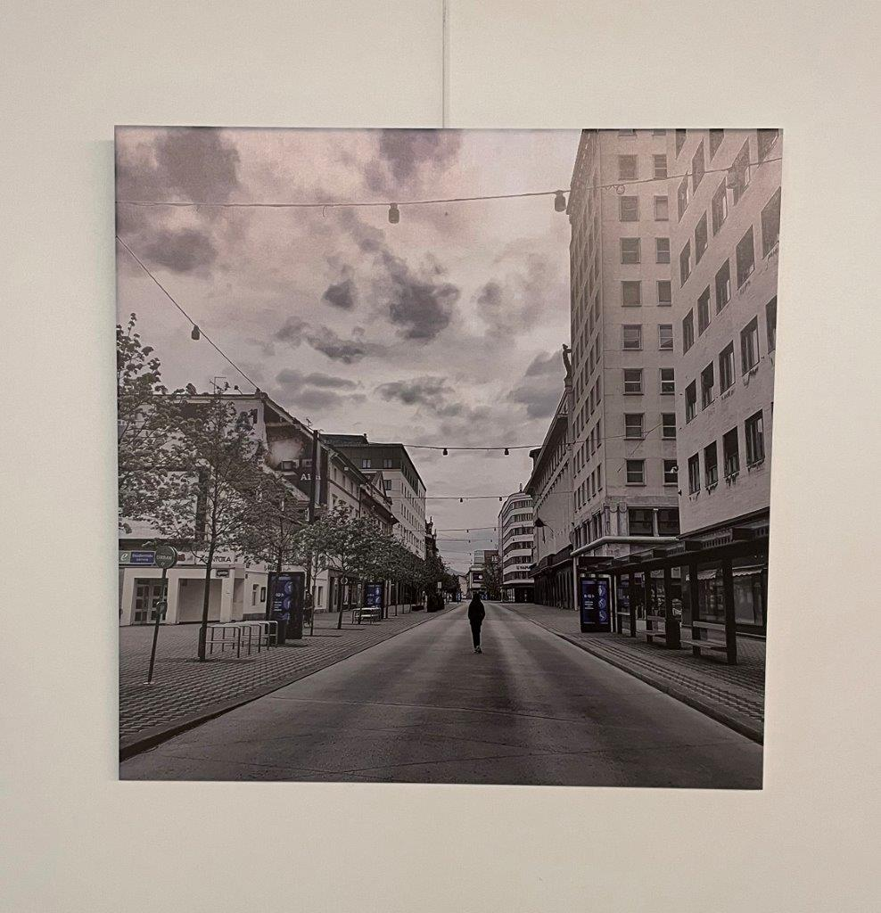
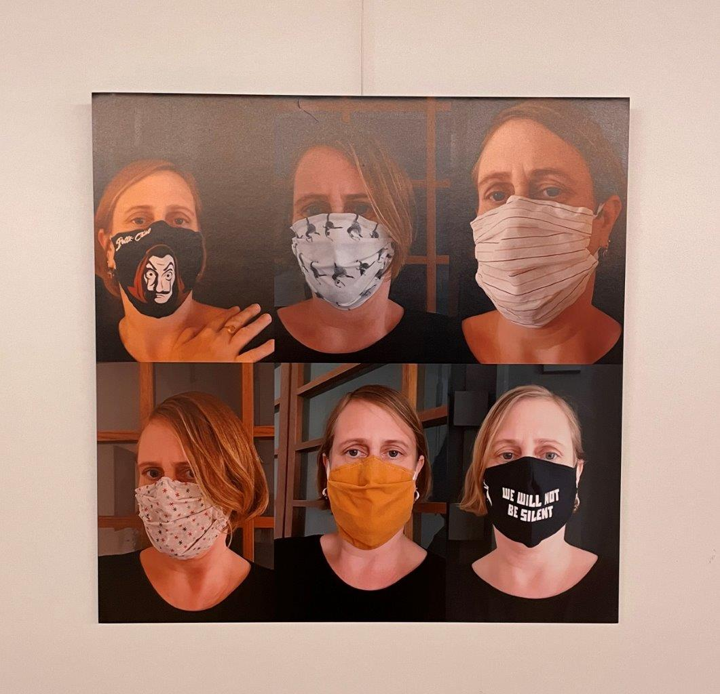
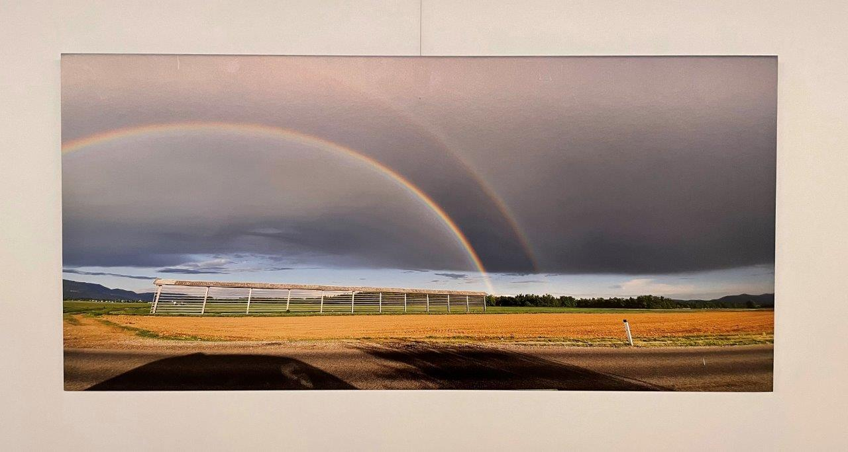
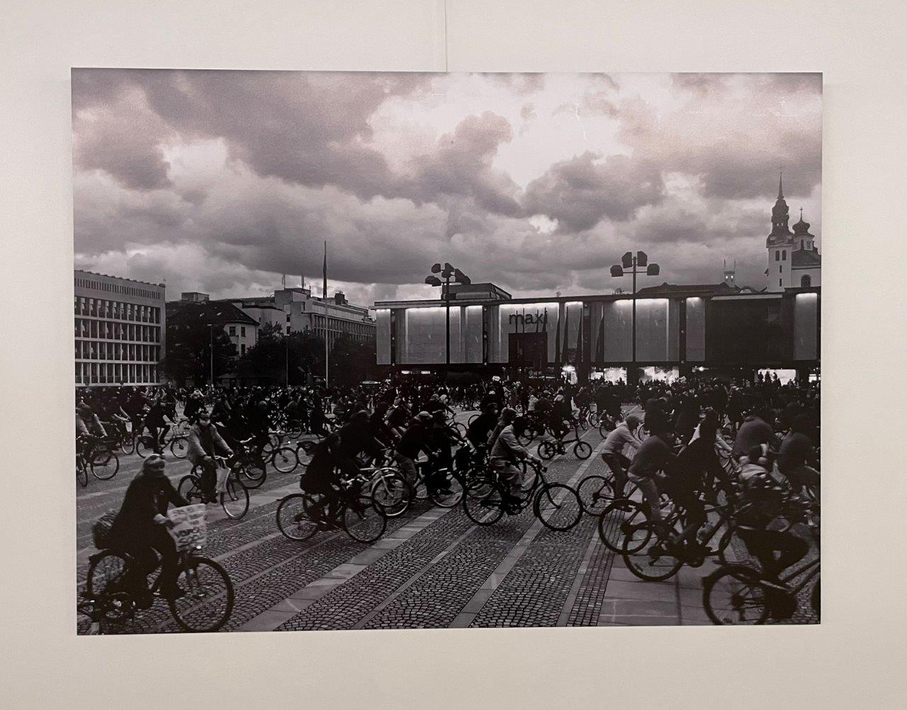
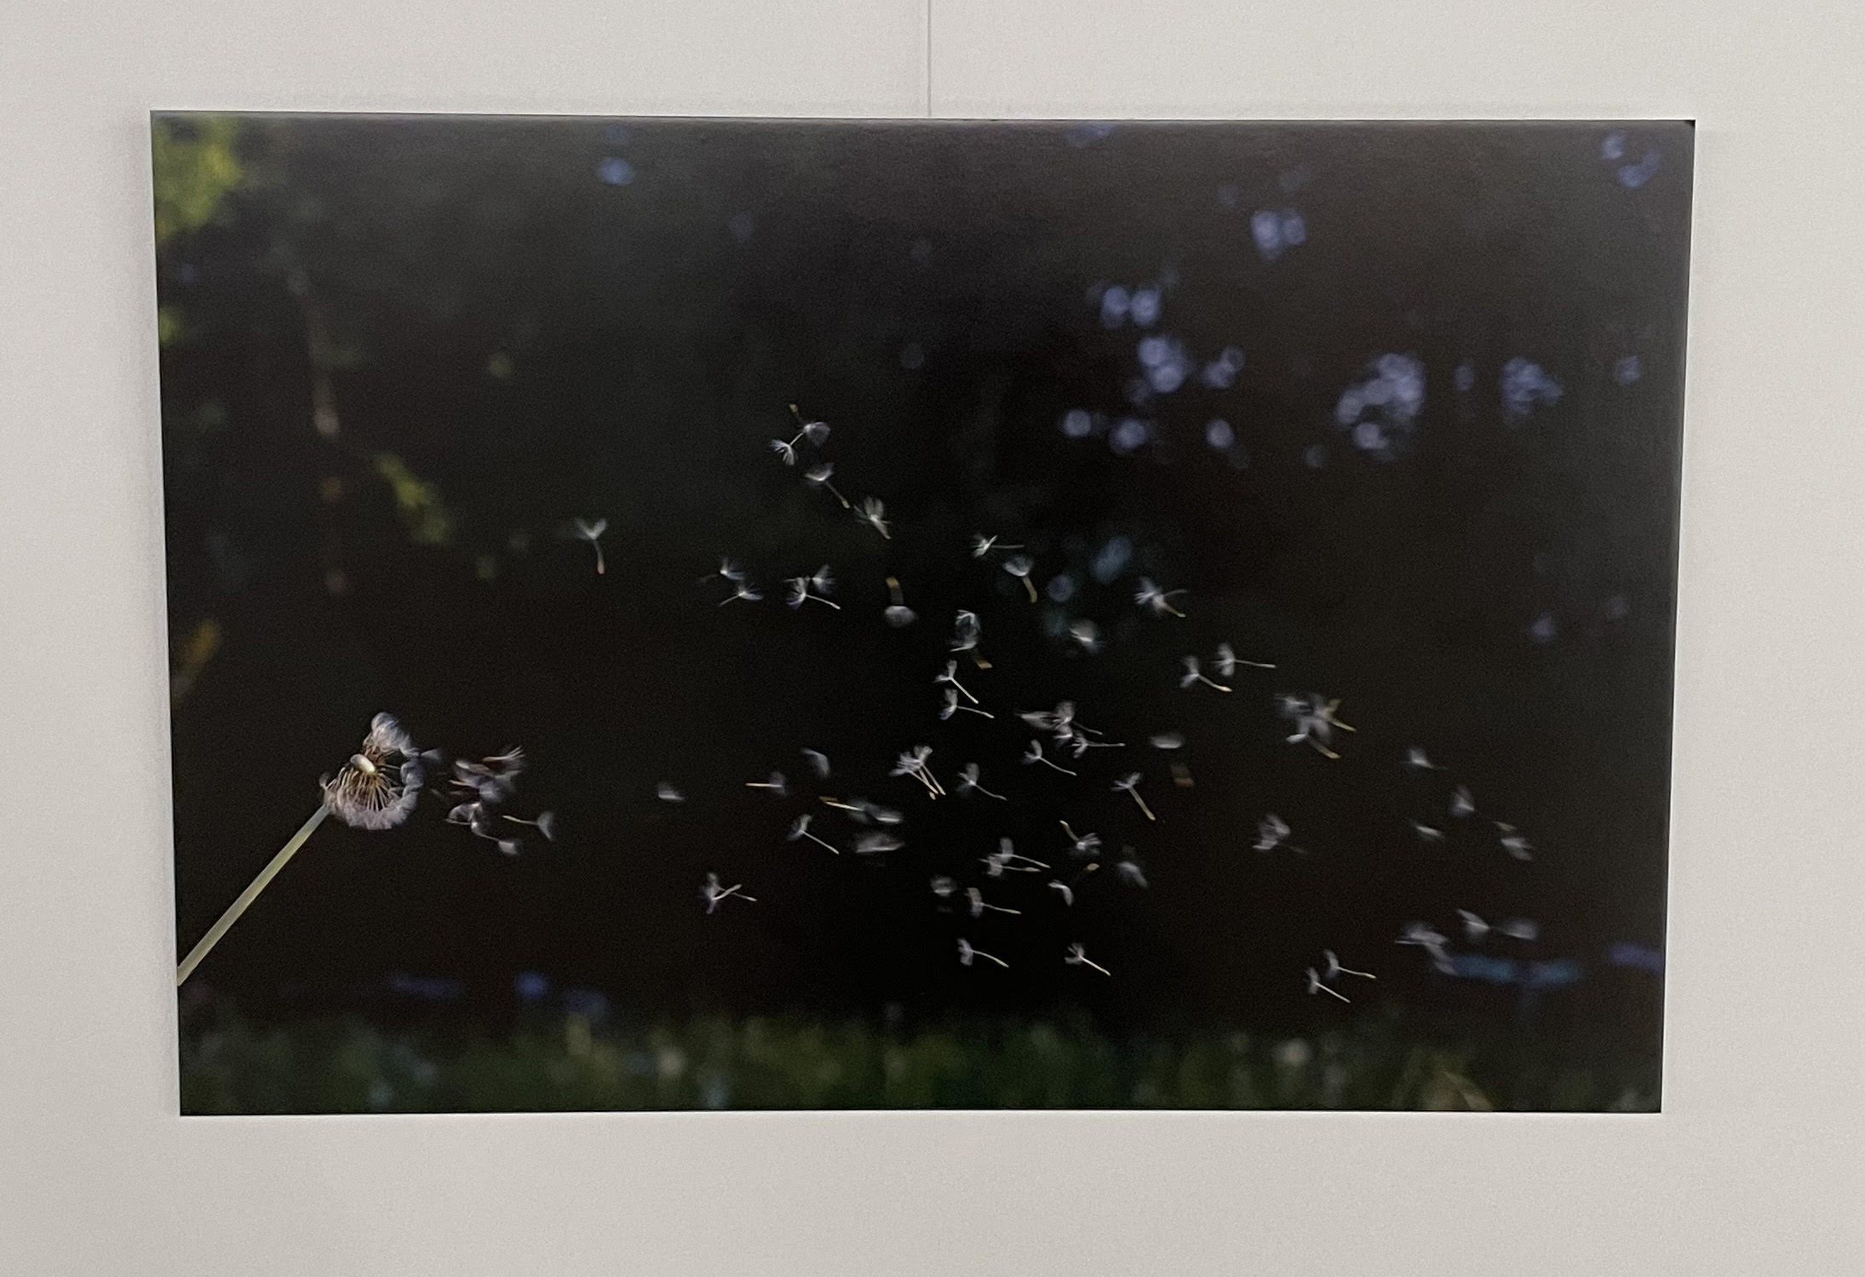
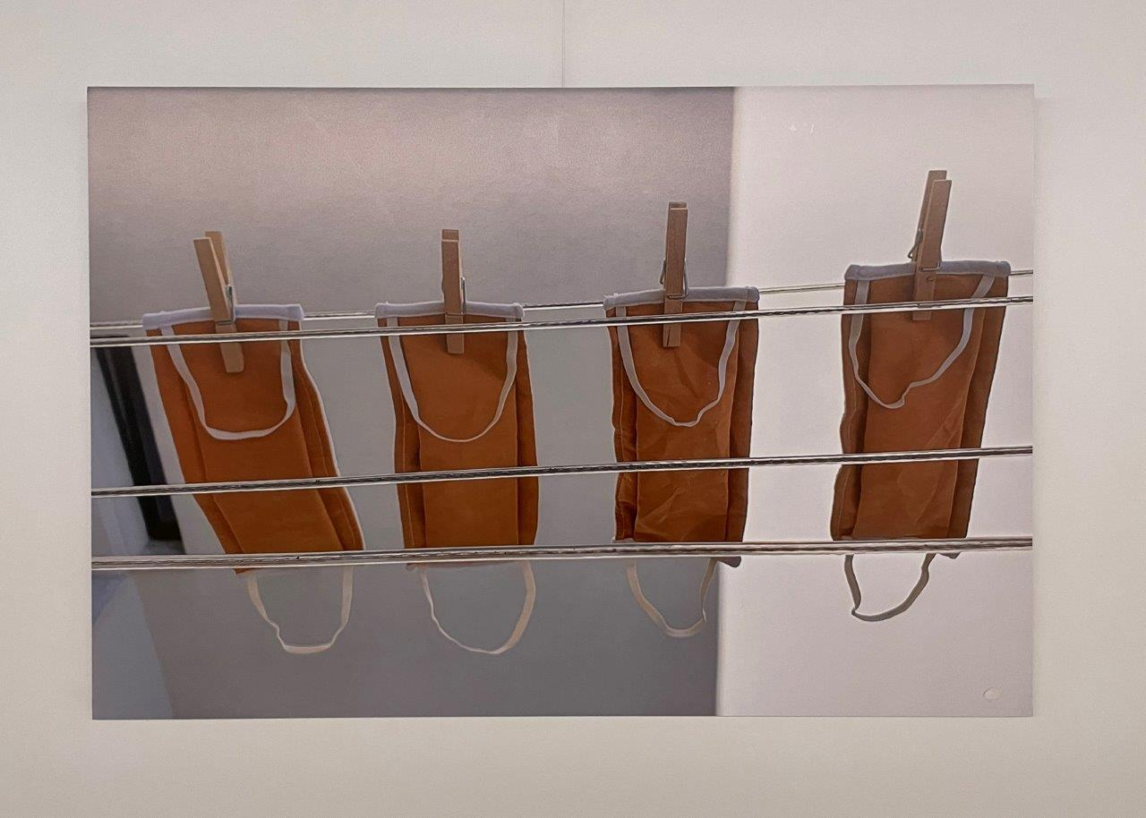
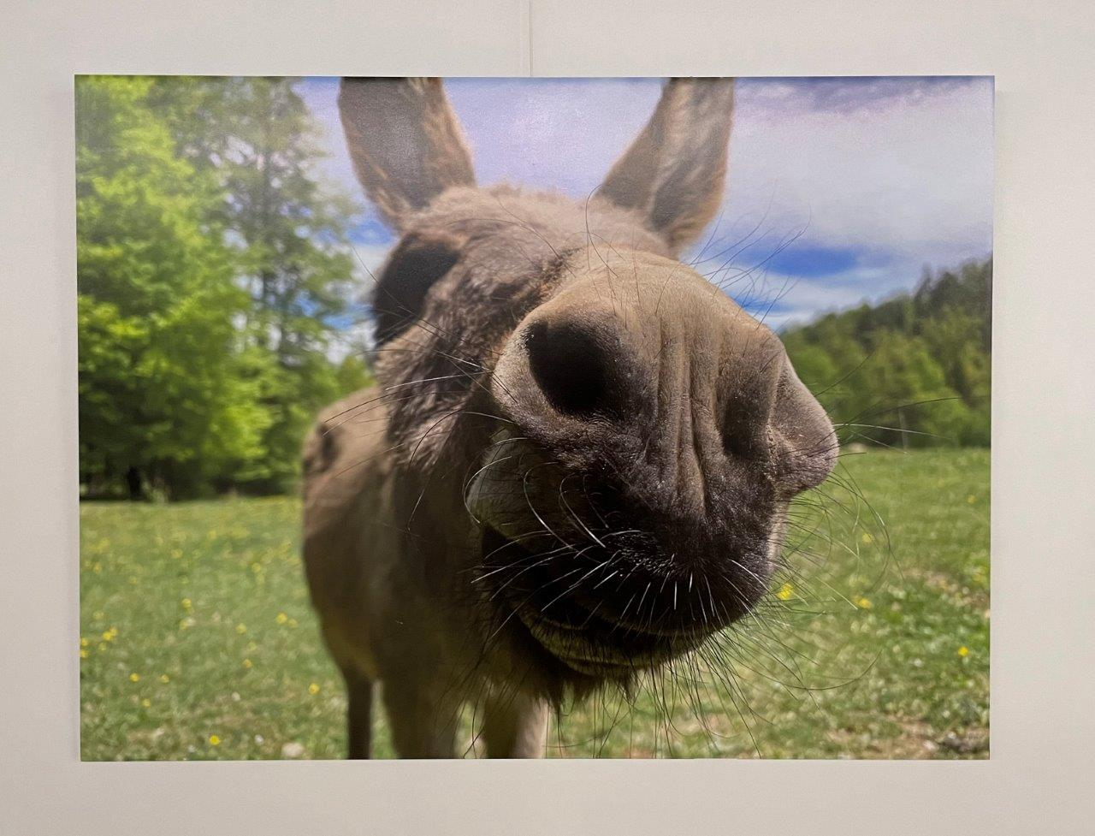
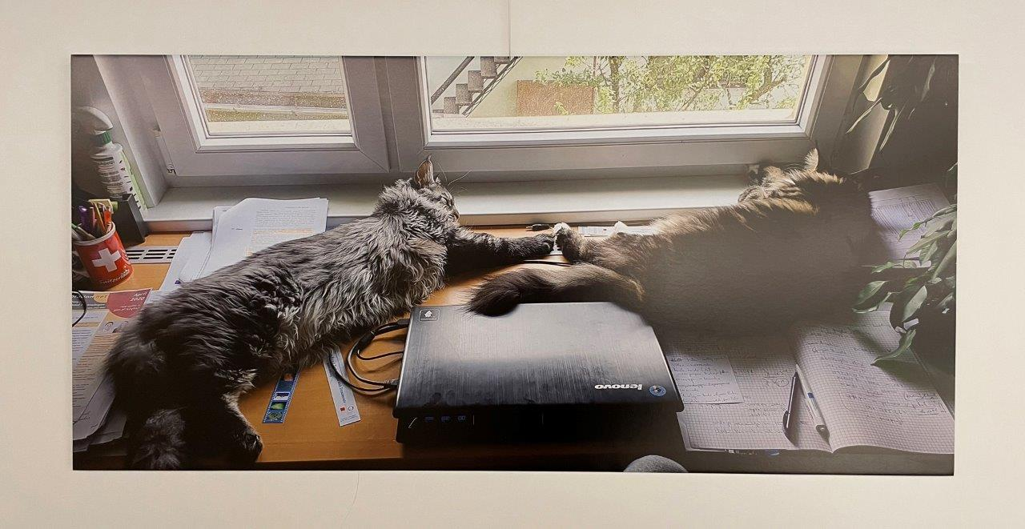
Virtual Guide to the LBK Photo Exhibition
COVID-19 (PART 1 – LOCKDOWN 1)
Accompanying story by Samo Mahnič-Kalamiza. All author’s rights reserved.

Slide 2
Desolation I.
Lockdown is taken seriously and people are reluctant to leave their homes. Those that do dare venture out into the open, find it a photographer’s bonanza.
Author: Samo MK
Author’s original title: no end in sight [ni konca na vidiku]

Slide 3
Desolation II.
The once busy streets brimming with tourists and locals now resemble those of a ghost town. Ljubljana’s ”Living room” being no exception, is a lot less living.
Author: Tina BN
Author’s original title: Friday @5pm [v petek ob 17h]

Slide 4
Survival I.
People stock up on yeast and flour, bread baking is an essential activity. Not necessarily to stave off the hunger, but rather the insanity of idleness.
Author: Kos B
Author’s original title: breadantine [kruhantena]

Slide 5
Survival II.
The quest of individuals for normality continues. The mask, originally filling a functional role, is now also a new fashion and statement item.
Author: Tina BN
Author’s original title: masks VI [maske VI]

Slide 6
The darkest hour./Exposure.
Shooting stars illuminate and die out, much as people’s dreams do. But the sea is calm, an occasional ripple – nature is ignorant of the pestilence upon mankind. City lights where the heavens meet the earth – a sliver of hope for civilisation.
Author: Anja Z
Author’s original title: Neowise comet [Neowise]

Slide 7
Uncertainty.
The morning dawns, revealing a cloudy skies. An ominous double rainbow looms over the horizon. A signal the viral flood is over*, or a weather phenomenon?
Author: Damijan M
Author’s original title: commodity reserves II [blagovne rezerve II]
*Genesis 9:13-16; https://www.kingjamesbibleonline.org/Genesis-Chapter-9/#13

Slide 8
The vignette.
The highways built to connect people across the country are vacant. Visiting other municipalities for the fun of it incurs punitive measures. The sun shines on indifferently.
Author: Peter K
Author’s original title: screaming void [kričeča praznina]

Slide 9
A family outing I.
Weather is inviting, families have washed and hung their masks out to dry while they are catching rays of sunshine outside.
Author: Tina BN
Author’s original title: the quartuplet [četverica]

Slide 10
A family outing II.
Fed up with restrictions and the new old ways of the government – machinations of a distasteful nature – people take to their bicycles, and ring their bells …
Author: Jessica G
Author’s original title: May 1st [1. maj]

Slide 11
A family outing III.
… but are taken for an ass. Their melodies of protest sound dead silence in the hallways of those in charge. Their ship is in troubled seas and taking on water, but refuses to sink.
Author: Peter K
Author’s original title: oi, wassup? [kuga je dej, ejga?]

Slide 12
Resignation I.
Resistance proven futile, many resign themselves to follow the course set out by the mad helmsmen, carried at the whimsy of the wind as dandelion parachutes …
Author: Alenka ML
Author’s original title: breeze [piš]

Slide 13
Resignation II.
… and continue to give the situation as much thought as two overly satisfied cats, warming themselves up by the window one fresh June morning in early May (sic*). The weather will eventually solve all their problems. Complacent as they are, they have ceased to remember what those problems even were in the first place. to be continued …
Author: Damijan M
Author’s original title: working from home [delo od doma]
*https://www.youtube.com/watch?v=A5gI11Gk8x4

